Slide 1
Spot To Go — Android App Project Presentation
Paithiyam University of East Anglia
Notes:
Good morning/afternoon, everyone. My name is Paithiyam, and today I'm going to walk you through Spot To Go, the Android app I've been building. Spot To Go helps people discover restaurants near them, see real details about each one, and even watch a short video of what the place actually looks like before deciding to go. I'll show you every screen in the app, and then explain how it all works behind the scenes.

Slide 2
What Is Spot To Go?
Helps users discover restaurants near their current location
Shows each restaurant's name, rating, distance, and cuisine type
Lets users watch a real video preview (YouTube or TikTok) before visiting
Gives instant turn-by-turn directions to the restaurant
Built as a modern Android app using Kotlin and Jetpack Compose
Notes:
So what exactly is Spot To Go? At its core, it's a simple idea: instead of guessing what a restaurant is like from a photo or a star rating, you can actually watch a short video of it first. The app uses the phone's location to find restaurants nearby, shows the important details like rating, distance and cuisine, and then gives a real video preview so the user knows what to expect. Once they've decided, one tap gives directions straight there. It's built using modern Android tools — Kotlin and Jetpack Compose — which is the current recommended way to build Android apps.

Slide 3
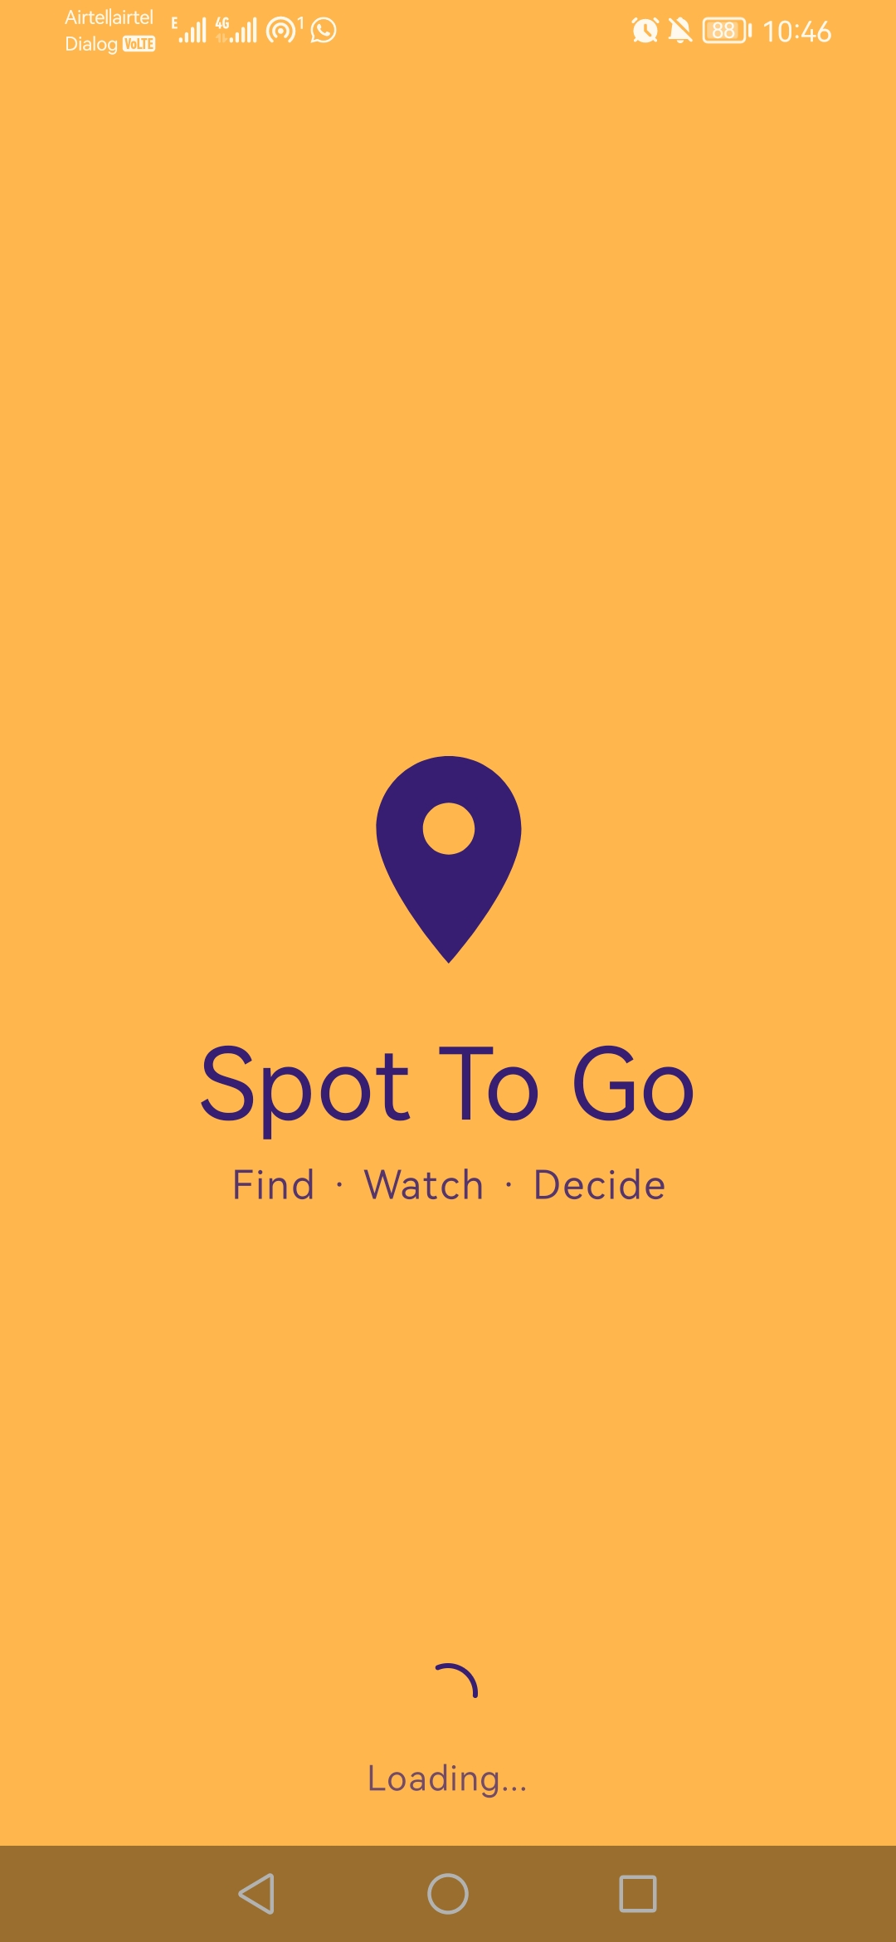
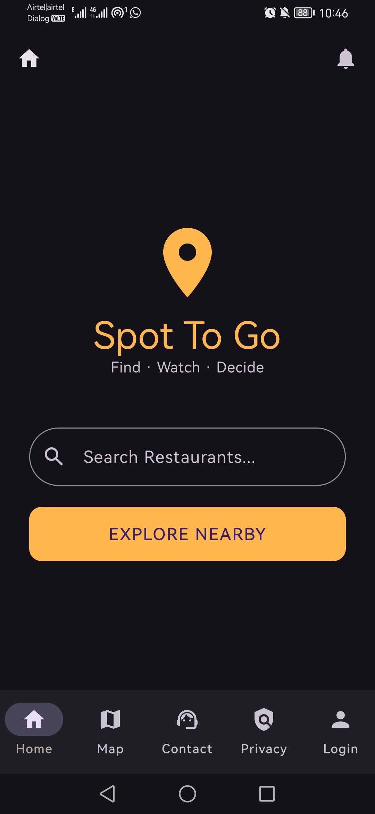
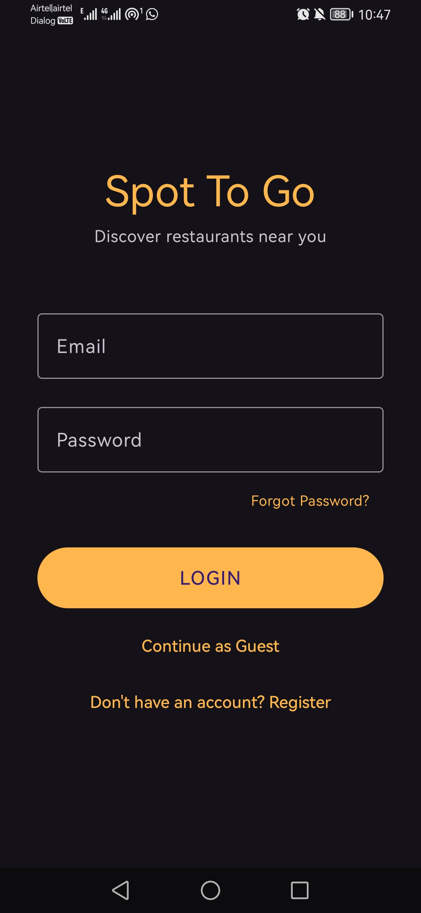
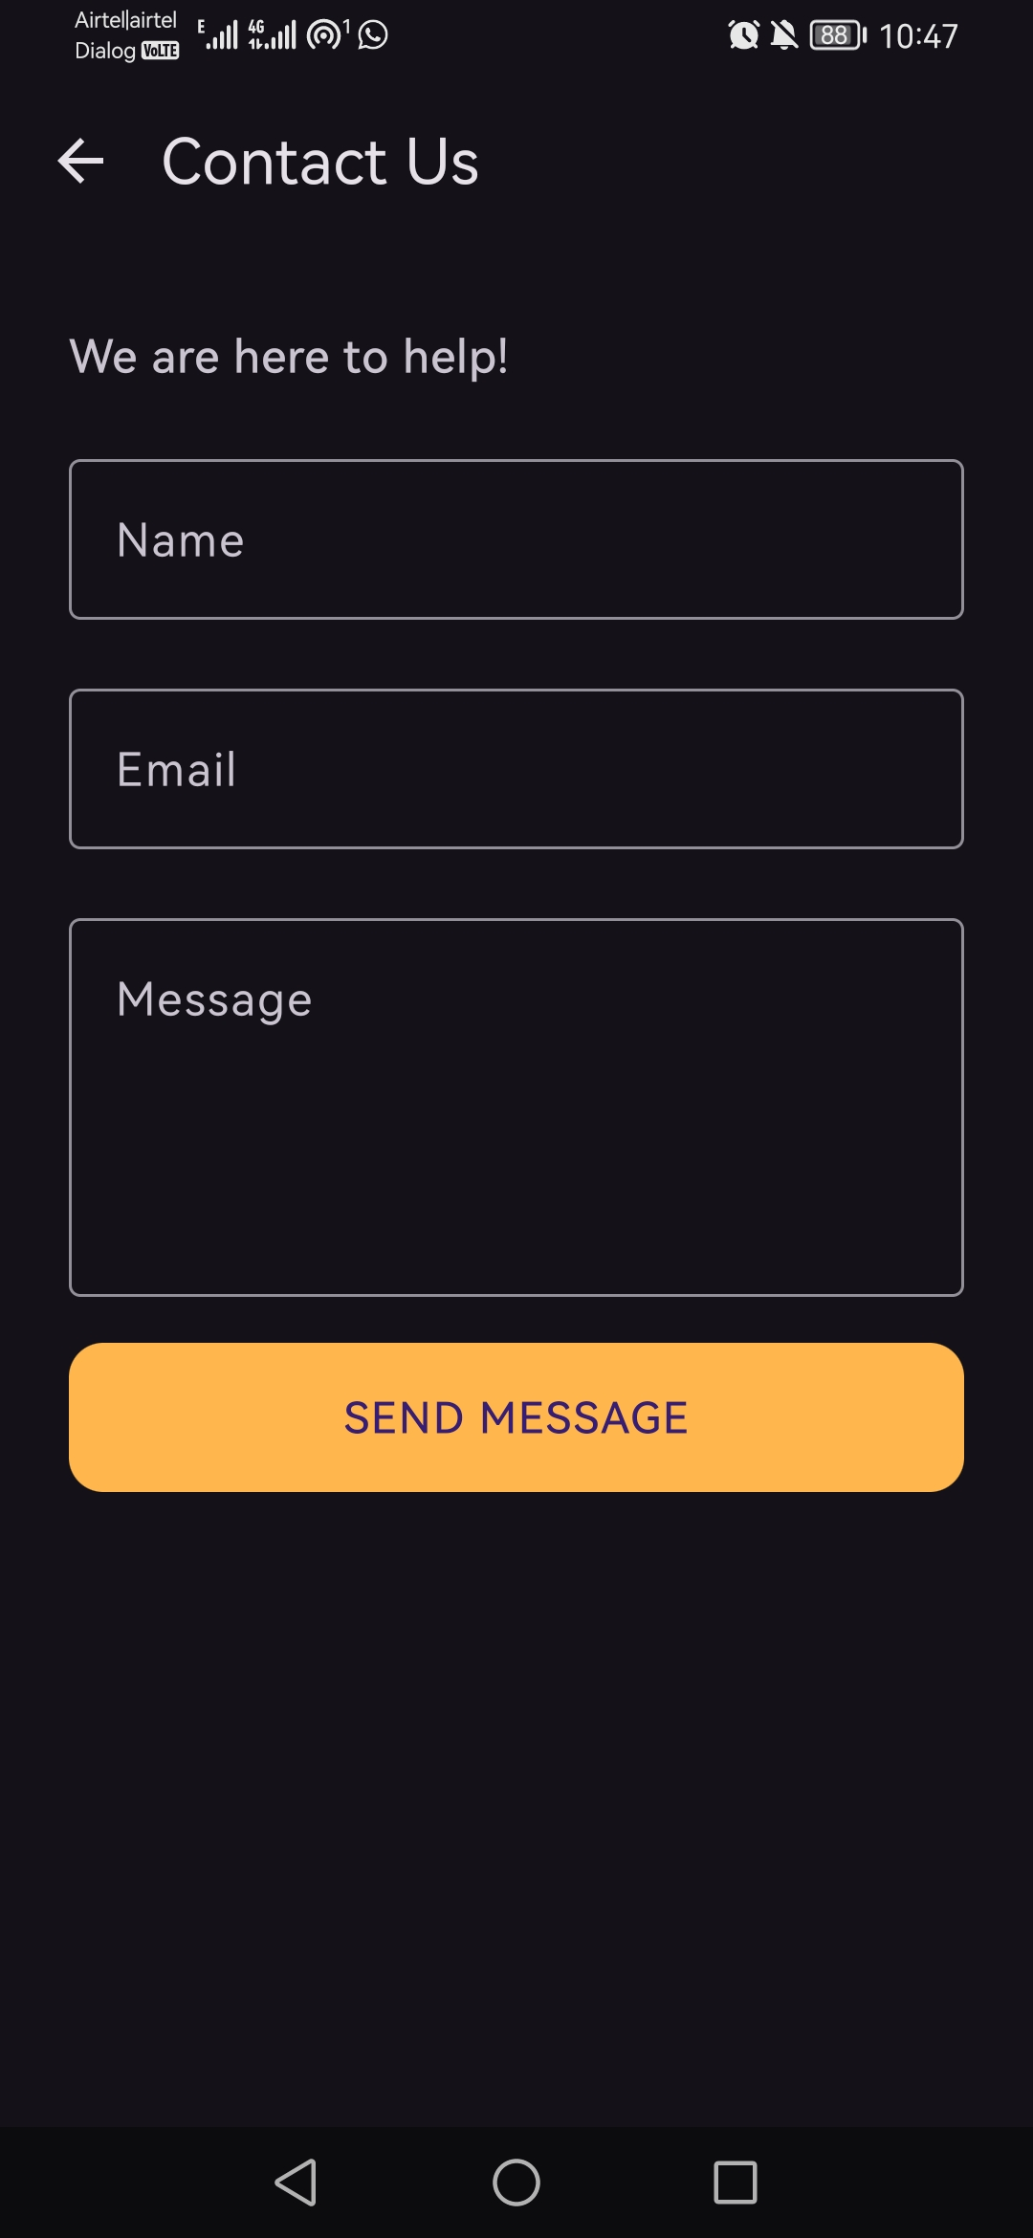
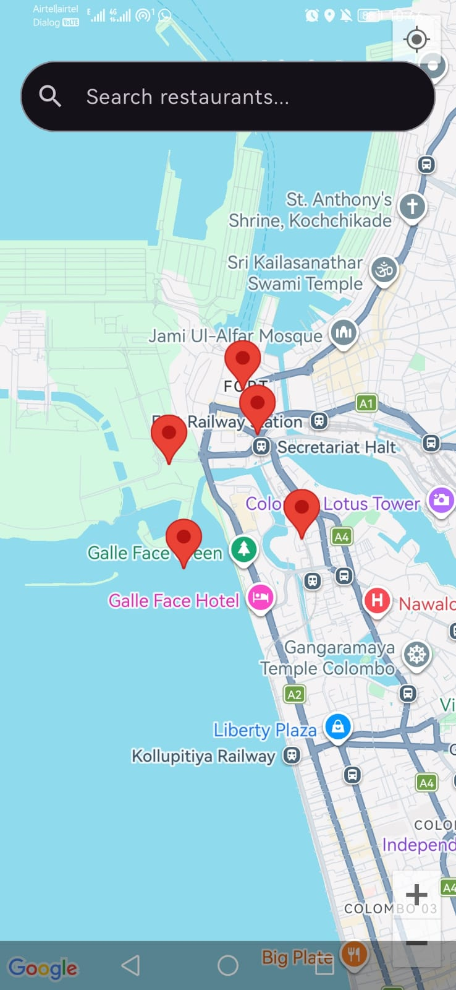
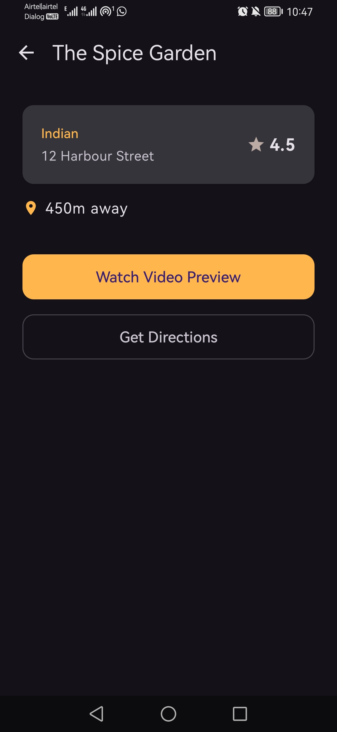
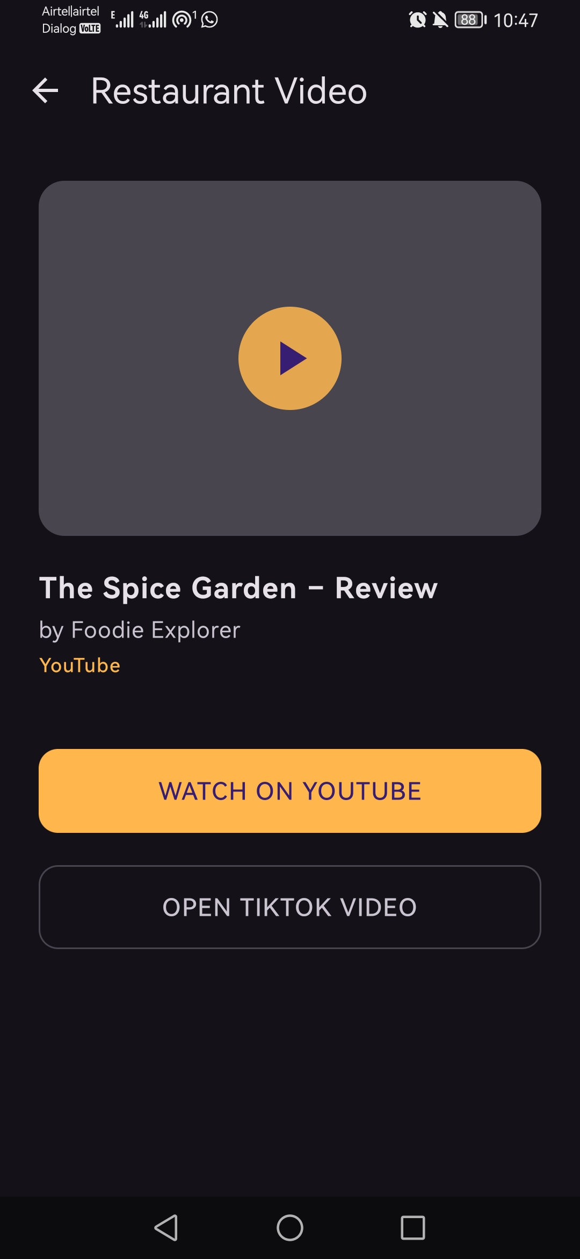
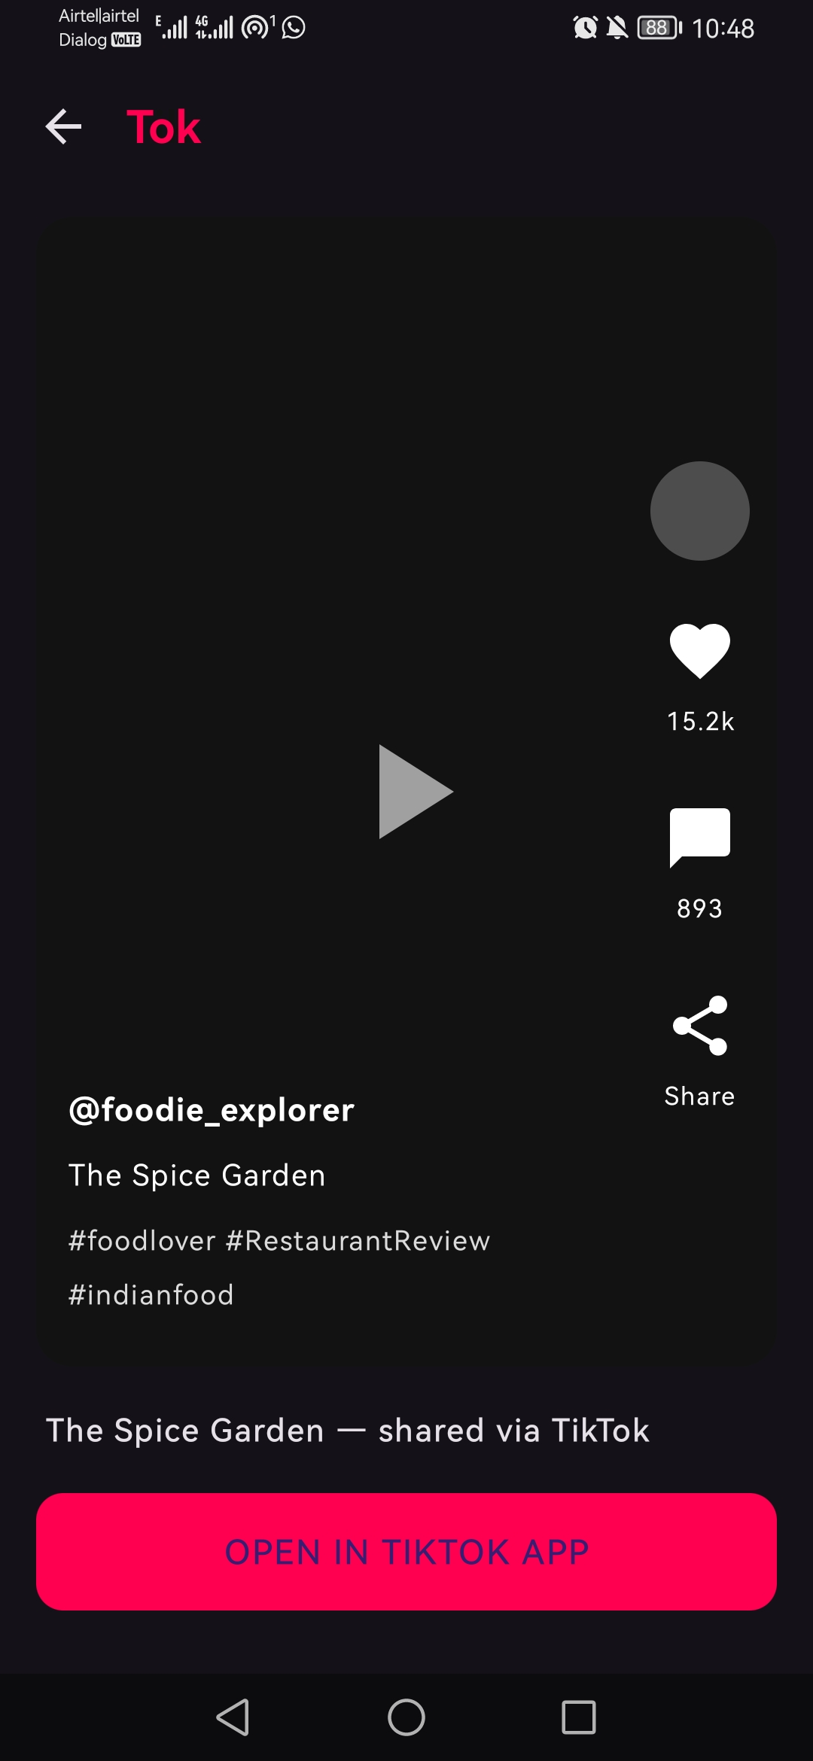
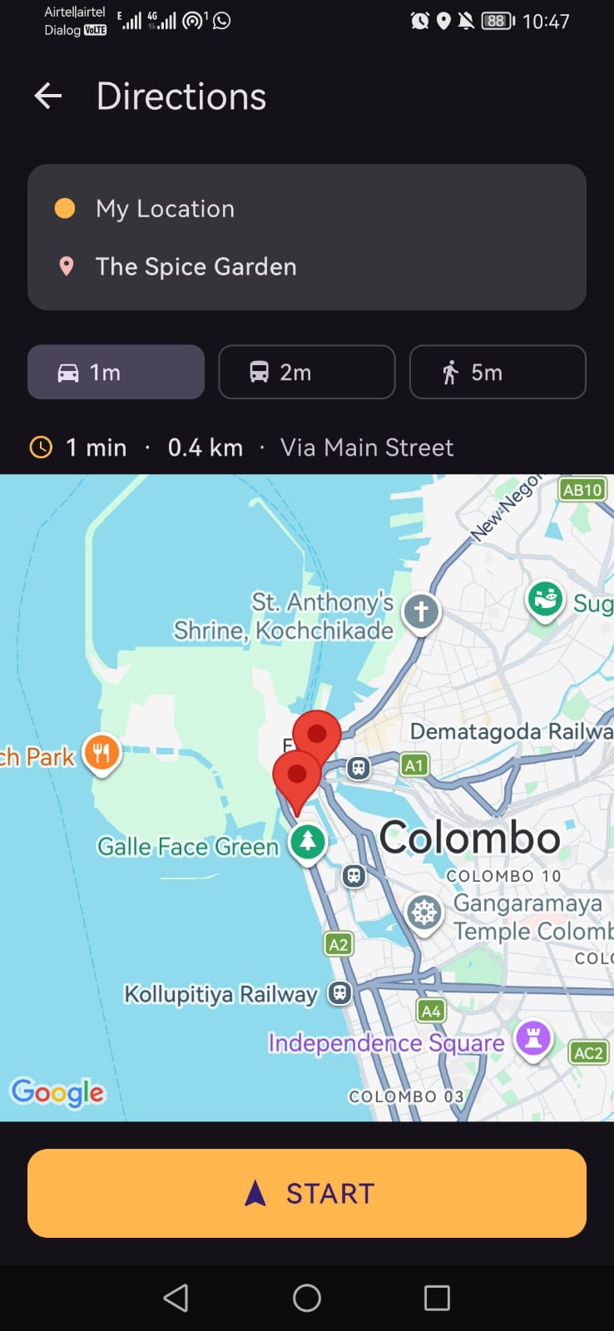
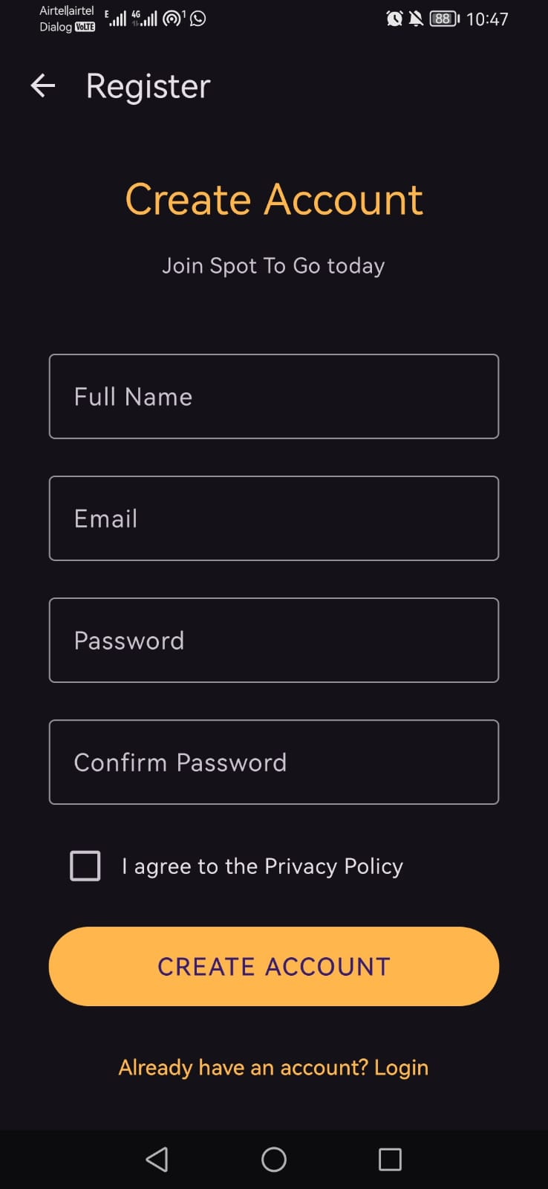
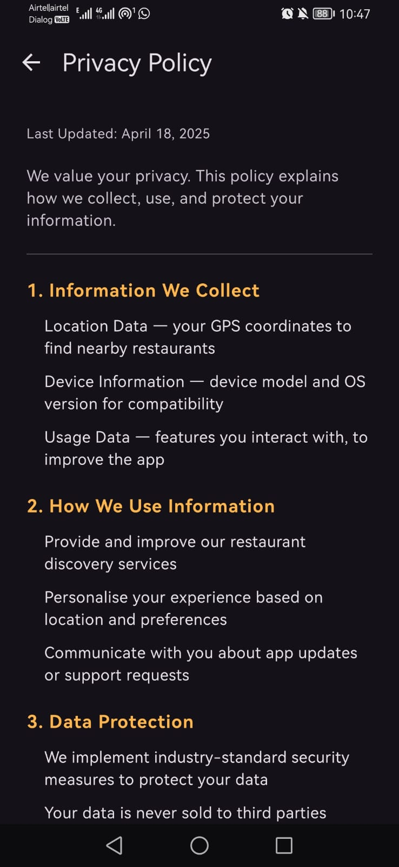
All App Screens
Every screen has been designed and built to match a simple, easy-to-follow flow.
Notes:
Let me show you every screen in the app. Starting with the top row: this is the Splash Screen, a short loading screen you see when you first open the app. Next is the Home Page, with a search bar and a button to explore nearby restaurants. Then the Login Page and the Registration Page, where a user creates an account or signs back in. After that, the Map Screen, which shows restaurants near the user's real location on a live map. And finally in this row, the Restaurant Detail page, showing the name, rating, distance and type of food. On the second row: the Watch Video screen, where users can preview a restaurant through YouTube or TikTok, the TikTok Link page with a branded preview, the Directions screen with walking, driving and bus options, the Contact Us page, and the Privacy Policy page. Every single one of these screens is fully built and working today.

Slide 4
How A User Moves Through The App
Splash Screen — a quick loading screen when the app opens
Login or Register — sign in, create an account, or continue as a guest
Home Page — search bar and quick access to nearby restaurants
Map Screen — restaurants shown near the user's real location
Restaurant Detail — name, rating, distance, and cuisine type
Watch Video — a real preview video of the restaurant
Directions — step-by-step navigation to the restaurant
Notes:
Now let's follow one typical journey through the app. A user opens the app and briefly sees the splash screen while things load. They then log in, register a new account, or simply continue as a guest. From the home page, they can search directly or tap Explore Nearby to jump straight to the map. The map shows restaurants around their real location using the phone's GPS. Tapping a restaurant opens its detail page, with the rating, distance and cuisine type. From there, they can either watch a real video preview of the restaurant, or tap Get Directions to open turn-by-turn navigation straight to the door. Every step connects smoothly to the next — nothing is a dead end.

Slide 5
What's Working Behind the Scenes
Real GPS Location
Finds restaurants near the user's actual position, not a fixed test location
Live Google Map
An interactive map with a real marker for every restaurant
Account System
Secure login and registration, tested on a real phone
Screen Navigation
Smooth movement between every screen, including a working back button
Opens Other Apps
The video button opens YouTube or TikTok, and directions open Google Maps
Smart Search
Typing in the search bar instantly filters which restaurants are shown
Notes:
Behind the screens you just saw, there's a real working system underneath. The app uses the phone's GPS to find the user's actual location, not a fixed test location. The map itself is a live Google Map, not an image — it can be zoomed and panned, and it holds real markers for each restaurant. Logging in and registering is handled by a real account system, and this has been tested on an actual physical phone, not just a simulator. Moving between every screen — including pressing back — is handled properly, so a user is never stuck with no way out. When someone taps Watch Video or Get Directions, the app opens the real YouTube, TikTok, or Google Maps app on the phone. And the search bar isn't just decoration — typing into it instantly filters the restaurants shown on the map.

Slide 6
Login & Account Security
Users can register a new account or log in with an existing one
Accounts are stored securely, not just kept on the phone
Users can also continue as a guest without creating an account
The map and restaurant features only unlock once a user is signed in
Tested end-to-end on a real Android phone
Notes:
Because Spot To Go stores personal accounts, security matters. Registration and login are both connected to a real account system, which keeps passwords and user details stored securely rather than just sitting on the phone. Users who don't want to register can still continue as a guest. To keep the experience personal and safe, the map and restaurant features only unlock once someone is actually signed in. All of this has been tested end-to-end on a real Android phone — registering a new account, logging in, and reaching the map — and it works exactly as intended.

Slide 7
Summary
All app screens are designed and fully working
A real login and account system is in place and tested
The map shows restaurants using the user's real location
Users can preview restaurants with real videos before visiting
One tap gives directions straight to the restaurant
Notes:
To summarise what you've seen today: every screen in Spot To Go is built and working, from the splash screen through to the privacy policy. There's a real login and account system behind it, tested on an actual phone. The map uses the user's real location to show nearby restaurants, and from there, users can preview a restaurant with a real video before deciding to go, then get directions with a single tap. That's Spot To Go so far.

Slide 8
What's Coming Next
Connect the map to real, live restaurant listings nearby
Make the search bar pull results directly from those live listings
Add a small safeguard so pressing back on the map doesn't close the app by accident
Notes:
So what comes next? Right now, the restaurants you saw on the map are a small sample set used to build and test every screen properly. The next step is to connect the map to real, live restaurant listings near the user, so the same experience you just saw works with genuine, up-to-date places. Once that's in place, the search bar will pull its results from those live listings directly, instead of filtering the sample set. Alongside that, there's one small polish item: pressing back on the map currently closes the app straight away, and we'll add a simple safeguard so that doesn't happen by accident. That's the plan for the next stage of Spot To Go. Thank you.

